Slide 1

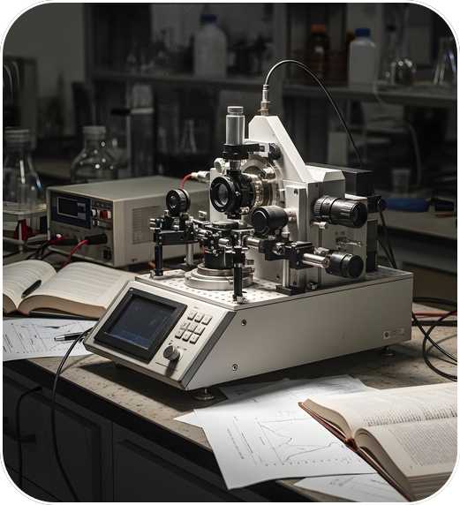

Self
Driving
Reinforcement learning for an autonomous synthesis lab
Presenters:
Saketcharan Chauhan M.
Abubakr Siddiq Mohammed.
100523729054
100523729063

Slide 2
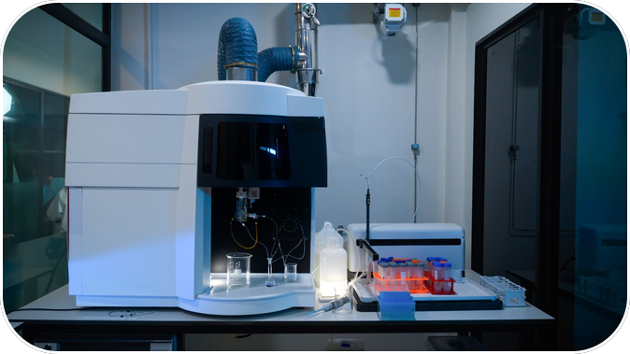

02
SCIENCE
Chemistry’s
Challenge
Trial & Error
RL Discovery
Manual trial and error consumes resources. Nonlinear temperature and concentration effects make optimization difficult.
Frame reaction tuning as sequential decisions to maximize yield.
Learn from sensor feedback within a 25-step experiment budget.

Slide 3
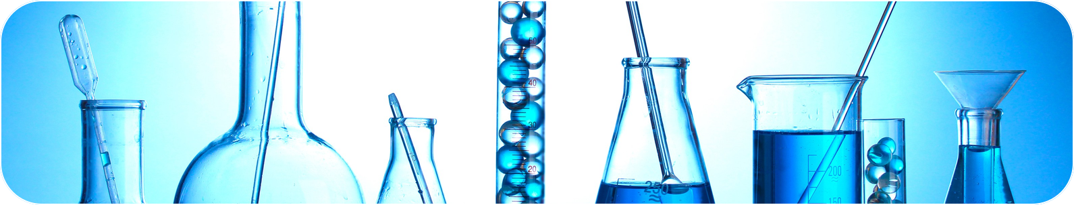
03
METHOD
State And
State Space
Action Space
Policy
Continuous 3D vector: temperature, concentration, and remaining budget fraction.
Adjusts temperature and concentration continuously.
Reward Score
REINFORCE
An MDP defines the process; REINFORCE learns actions that maximize discounted yield.
Rewards yield while penalizing reagent consumption.
A PyTorch MLP outputs a Gaussian continuous action distribution, optimized via Monte Carlo sampling over 500 episodes to maximize discounted returns.

Slide 4
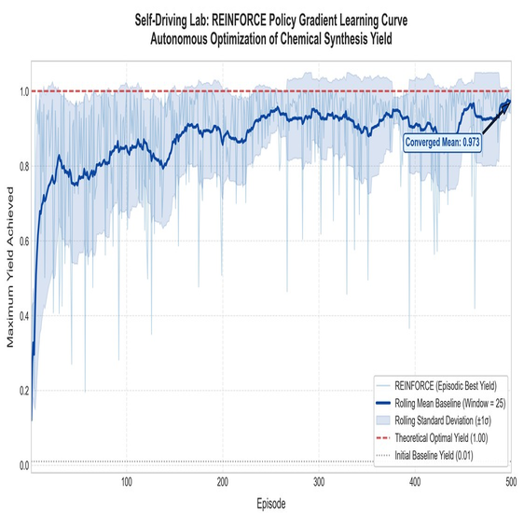
04
RESULTS
01
Peak
Global Optimum
Converged steadily to 100.0% global optimum despite sensor noise.
Yield
02
Optimal Point
Optimal conditions at 83.72°C and 1.21M.
03
Stable Learning
50-episode average rose from 0.7595 to 0.9477.

Slide 5
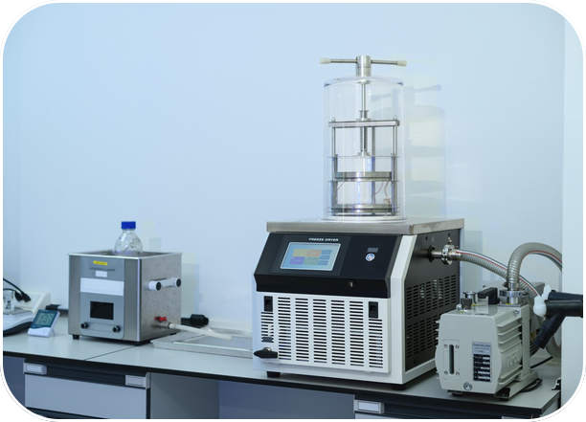
05
SIM-TO-REAL GAP
Real Lab
Complexity
Sim-to-Real gap: simulator assumptions of instant feedback, zero-latency temperatures, and ideal Gaussian noise hide real lab delays, hardware latency, and imperfect noise.
Delayed
Lagged
Noisy
Assays take time; results are not instant.
Hardware needs time to reach target temperatures.
Bias and anomalies disrupt idealized noise.

Slide 6


06
ETHICS
Safe lab
use
Dual-use risk: RL enables algorithmic optimization of illicit or toxic substances.
HARD LOCKOUTS
LIMIT REAGENTS
AI practitioners must hardcode safety lockouts and restricted chemical inventories, never relying on the reward function alone.

